Slide 1

Student Number (If this is group work, please include the student numbers of all group participants) | GH1043274, GH1040589, GH1040720, GH1044321
Assessment Title | lululemon - “Legacy in Motion”: A Digital Marketing Strategy to Strengthen Market Leadership Across Europe.
Assessment Title | lululemon - “Legacy in Motion”: A Digital Marketing Strategy to Strengthen Market Leadership Across Europe.
Module Code | M509
Module Title | Digital Marketing and Analytics
Module Tutor | Prof. Stratis Efthymiou
Date Submitted | 14.12.2025
Declaration of Authorship
We declare that all material in this assessment is our work except where there are clear acknowledgements and appropriate references to the work of others. We fully understand that the unacknowledged inclusion of another person’s writings, ideas or works in this work may be considered plagiarism and that, should a formal investigation process confirm the allegation, we would be subject to the penalties associated with plagiarism, as per GISMA Business School, University of Applied Sciences’ regulations for academic misconduct.
Signed: Carl Jhon Odicta, Sandesh Shrishail Madannavar, Yohannes Terefe Furgasa, Rakesh Nelli.
Date: 14.12.2025

Slide 2




Presented By: | Carl Jhon Odicta (GH1043274) Sandesh Shrishail Madannavar (GH1040589) Yohannes Terefe Furgasa (GH1040720) Rakesh Nelli (GH1044321)
Module Code | M509
Module Title | Digital Marketing and Analytics
Module Tutor | Prof. Stratis Efthymiou

Slide 3





lululemon
“Legacy in Motion”: A Digital Marketing Strategy to Strengthen Market Leadership Across Europe.

Slide 4
AGENDA
Objectives of the Presentation
Company Overview
Digital Marketing Strategy
Theoretical Background (SWOT and STP)
Comprehensive Market Research and Market Gap
Competitive Analysis
Brand Positioning and 4P’s
Sales Channel, Content Strategy, and KPI’s
Recommendations and Conclusion
References

Slide 5
OBJECTIVES
Understand the German & European consumer mindset with the help of the theoretical background.
Build a marketing strategy with the help of a creative campaign to develop leadership across Europe.
Propose a customer-driven digital marketing strategy/campaign.
Evaluate Comprehensive Market Research and Competitive Analysis.
Identify Market Gap and channels for international expansion.
Recommend cutting-edge technologies to drive engagement and community.
Deliver a compelling, scalable strategy based on data and marketing theory

Slide 6





COMPANY OVERVIEW
Who We Are & Our Origins
Global technical athletic-apparel & lifestyle brand focused on yoga, training, running and everyday wellness wear.
Founded by Chip Wilson in 1998 in Vancouver, Canada; first store opened 2000.
Evolved from women’s yoga wear to a full range: yoga, running, training apparel for women & men.
Publicly listed since 2007; now a worldwide brand across markets.
Strategy, Market Position & Growth Vision
Positioning: premium performance-lifestyle brand blending product innovation, quality, and community.
Strategic growth pillars: expand men’s business, accelerate digital/e-commerce channels, and increase international/global footprint.
Differentiation via high-performance fabrics, durable product design, and community-driven experiences (yoga events, wellness & fitness community engagement).
Long-term ambition: build and strengthen market leadership in Europe and globally through localized brand presence + digital expansion.
Purpose & Values: What Drives Us
“Elevate human potential by helping people feel their best.”
Empower wellbeing: physical, mental, social — through movement, mindfulness, and connection.
www.lululemon.de/en-de/home

Slide 7


Campaign: “Legacy in Motion”
Objective: Reignite lululemon’s streetwear and sports legacy for All Generation.
Theme: Blend nostalgia with modern performance and life-style.
Key Message: lululemon isn’t just a logo—it’s a movement, mindfulness, and connection.. From fitness fields to city streets, the legacy lives on.
DIGITAL MARKETING STRATEGY
Community Building
Youth today expect more than just clothing: they look for community, a sense of belongingness, digital experiences, and lifestyle alignment.
This is where Lululemon’s ’Power of Three’ strategic plan could come in: Brand ambassadors, content creation, and Store events.
Power of Three ×2
Product Innovation
Guest Experience
International Expansion

Slide 8
THEORETICAL BACKGROUND
Digital marketing: is the strategic use of digital channels and data-driven insights to drive business growth.
SWOT ANALYSIS MODEL
STRENGTHS
WEAKNESSES
OPPORTUNITIES
THREATS
Strong global brand identity associated with premium quality and performance apparel.
Loyal customer base due to product innovation, fabric technology, and community-driven engagement.
Effective omnichannel strategy (stores + e-commerce + community events).
High margins and strong financial stability enabling international investment.
Higher price points compared to European competitors like Adidas, Puma, Decathlon — risk of price sensitivity.
Limited brand awareness in some European markets.
Reliance on niche segments (yoga, premium athletic wear).
Rising demand for athleisure and wellness lifestyle in Europe.
Growing digital adoption (e-commerce + social commerce).
Increasing interest in sustainable and ethical fashion.
Expansion into men’s wear and broader fitness categories.
Intense competition from European brands (Adidas, Nike, Gymshark).
Economic fluctuations affecting discretionary spending.
Cultural differences in fitness behaviour across Europe.
Regulatory pressures regarding sustainability, materials, and privacy.

Slide 9



STP MODEL
SEGMENTATION | TARGETING | POSITIONING
Demographics: age 18–45, working professionals, fitness enthusiasts. Psychographics: wellness-focused, premium lifestyle, sustainability-oriented. Behavioural: gym-goers, yoga practitioners, runners, athleisure users. | Urban, health-conscious consumers with disposable income. Growth segments: male athletes, runners, hybrid office workers who prefer athleisure daily wear. Digital-first consumers who engage through social media, influencers, and online communities. | “Lululemon positions itself as a premium athletic lifestyle brand that blends high-performance innovation with wellbeing, mindfulness, and community.” This positioning highlights quality, sustainability, comfort, and holistic wellness, differentiating it from purely sports-performance brands.
LEGAL & RISK MITIGATION
Compliance with GDPR (General Data Protection Regulation)
Transparent and secure data handling: Obtaining customer consent, managing personal and e-commerce data safely, and maintaining clear cookie, data retention, and opt-out policies.
Regulated digital marketing practices: Ensuring all activities, including email campaigns, retargeting, and analytics, comply strictly with GDPR regulations.
EU Eco-friendly Product Standards
Sustainable product compliance: Using certified eco-friendly fabrics, following safe production methods, and adhering to EU REACH, eco-label, and textile labelling standards.
Transparency and accountability: Reporting environmental impact and ensuring sustainable practices across the supply chain.
Market Risks & Mitigation
Regulatory and operational risks: Manage legal changes, data protection threats, and market volatility through compliance monitoring, cybersecurity, GDPR training, and diversified pricing/product strategies.
Market and cultural risks: Address competition and cultural differences by leveraging local market research, innovation, and premium, differentiated product design.

Slide 10
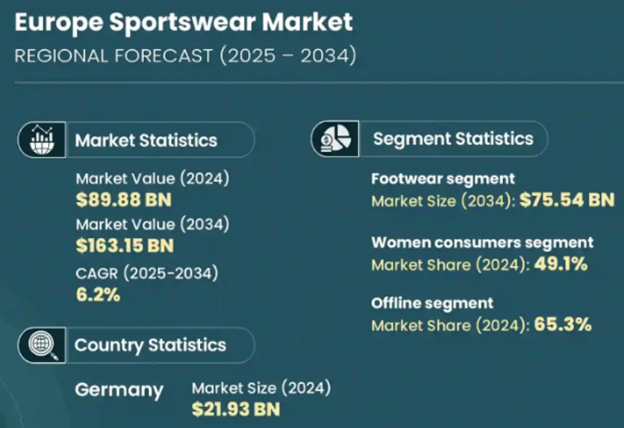
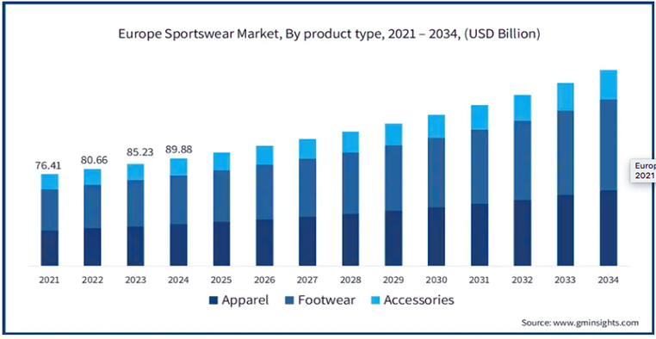
MARKET RESEARCH
“Post-Pandemic, the consumer is a lot more conscious and educated around fitness and, as a result, the demand for sports across the world is at an all-time high.”
- Michael Murray, CEO, Frasers Group
The Europe sportswear market size was estimated at around USD 89.88 billion in 2024 and forecasted to grow significantly at an estimate compound annual growth rate (CAGR) of 6.2%.
And Germany has a significant share of this market at USD 21.93 billion which is around ~24% in 2024. (gminsights.com)

Slide 11
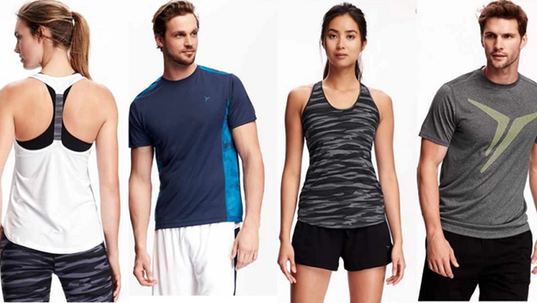
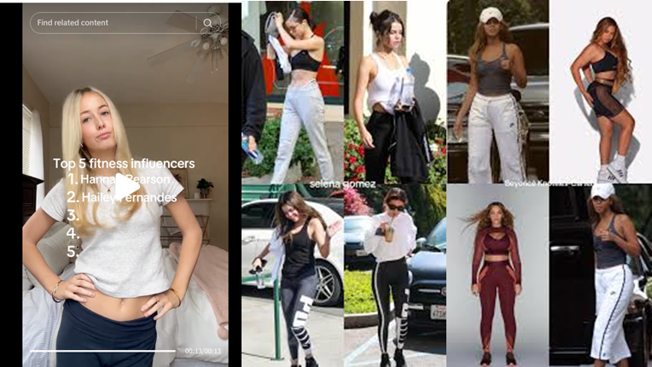
YOUTH/YOUNG ADULTS PREFERENCE TO ATHLEISURE
As current lifestyles increasingly incorporates fitness and wellness to everyday activities, a trend is introduced where active wear was combined with fashion and is no longer just for workouts, but also for daily wear and social identity — especially among the youth.
Major retailers report that “Athleisure” - clothing that blends performance, comfort, and everyday lifestyle - categories consistently outperform traditional fashion segments. (industryresearch.biz)
ACTIVE WEAR VS ATHLEISURE
Today, socialization and even teen sports culture is becoming increasingly digital and has an effect in consumer purchasing behavior. 54% of shoppers do a search on social media for product reviews posted by influencers before making a buy. (Devi S. & Mahapatra S.N., 2022)
The rise of social media fitness influencers and celebrity posts (in platforms like tiktok and instagram) has amplified demand, with athleisure brands leveraging digital marketing strategies to reach target audiences. (emergenresearch.com)

Slide 12
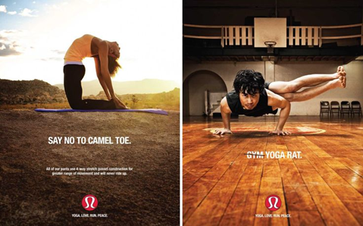

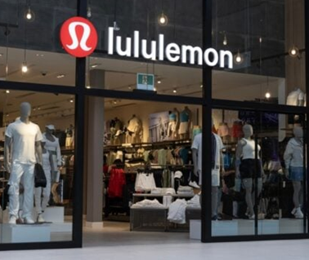
MARKET GAP
There is NO major fitness wear brand offering: Fashionable Lifestyle, Accessible Premium, and Community-Driven products for European Teens
Accessible Premium
A balance between Affordability vs Premium Quality creates an opportunity for a brand offering “accessible premium”: high-quality products but affordable for teens.
Fashionable Lifestyle
Community-Driven
Trends in urban wellness and fitness results in a blend of fitness + fashion + social identity among teens and Gen Z, there's a demand for brands that reflect that lifestyle — not just sportswear.
A brand that feels “theirs”: youthful, inclusive, socially aware, digitally connected, and identity-affirming.
Youth today expect more than just clothing: they look for community, a sense of belongingness, digital experiences, and lifestyle alignment.
This is where Lululemon’s ’Power of Three’ strategic plan could come in: Brand ambassadors, content creation, and Store events.
Lululemon can fill this gap: ”It’s so much more than apparel; it’s about people."

Slide 13
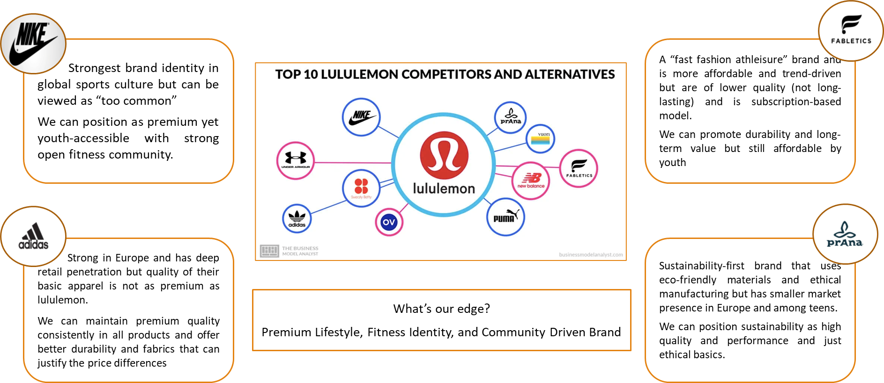
COMPETITIVE ANALYSIS

Slide 14


BRAND POSITIONING (EUROPE FOCUS)
“Lululemon - the destination for active teens and millennials, who want high-performance apparel, stylish expression and an inclusive community where they can learn, sweat and grow.”
Positioning pillars:
Youth empowerment
Community-first
Digital accessibility
Inclusivity
Product excellence combined with a belonging position to meets teens’ desire for identity, confidence, motivation and community support in their pursuit of fitness.
CONSUMER PERSONA
The target group will be mostly “Fit-Gen Teen” Personals and millennials (specifically those whose age are between 18–45)
Lifestyle: gym, school sports, dance, fitness clubs
Platforms: TikTok, Instagram, Snapchat
Main needs:
Affordable entry options
Fun, social, youth-friendly fitness content
Sense of belonging
Brands that reflect their values

Slide 15
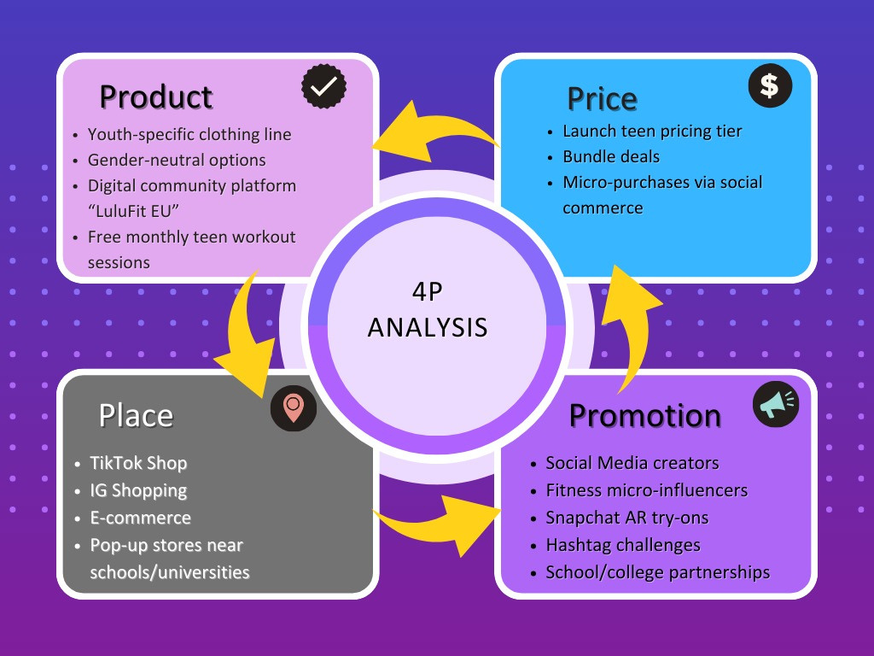
4P’S FRAMEWORK

Slide 16
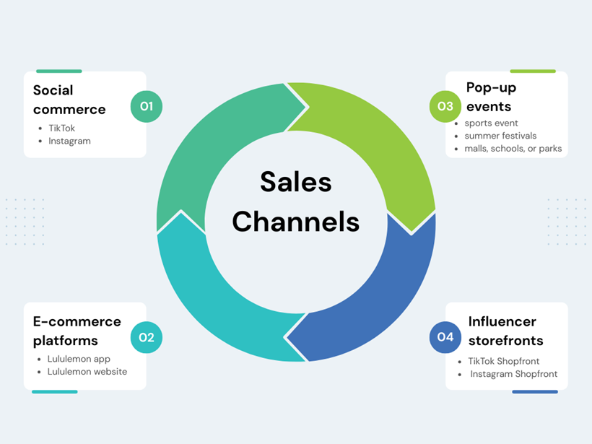
SALE CHANNELS
Digital Channels:
Instagram: Reels, teen influencers, workout tips, challenges.
TikTok: Trending flares-challenges, brief training videos and ideas for what to wear.
YouTube: Workouts for beginners, ambassador features and community recaps.
Opinion About Official Web & APP：Event calender, product drops, blog post.
Email & Push Notifications: Updates on events, challenges and new drops.
Offline Channels:
Lululemon Stores as Community Hubs.
Free kid-friendly yoga and HIIT sessions If your kid wants to challenge you in the fitness activity.
Beginner classes to build confidence.
Pop-up Events at schools, parks and other public locations.
Local Teen Ambassadors: Young athletes, dancers, runners, early fitness leaders.

Slide 17

DIGITAL MARKETING CAMPAIGN EXECUTION STEPS
Step 1: Campaign Planning & Goal Setting (Weeks 1–2)
Step 2: Creative Development (Weeks 2–4)
Step 3: Influencer & Ambassador Onboarding (Weeks 3–6)
Step 4: Soft Launch – Teaser Phase (Week 6)
Step 5: Campaign Launch – “Legacy in Motion” (Week 7)
Step 6: Engagement & Community Activation (Weeks 8–14)
Step 7: Performance Tracking & Optimization (Ongoing)
Step 8: Campaign Wrap-Up & Reporting (Final Week)

Slide 18


CONTENT STRATEGY
Hero Content Series:
“lululemon Rewind” – Weekly throwbacks to iconic sports moments
“Styled by You” – campaign with fan-submitted outfits
“Winning Starts Within” – Mental wellness stories from athletes
“lululemon x Creators” – Micro-influencer styling challenges
Conversion Boosters:
Countdown timers for drops
Geo-targeted ads for pop-ups
Loyalty program: “lulu Club”
Pillars:
Inspiring fitness stories
Tutorials & challenges
“Train with me” clips
Behind-the-scenes at Lululemon
Body positivity and inclusivity
User Generated Content (UGC) fitness transformations
Weekly “LuluFit Friday” tips
Show everyday “gym-to-street” outfit ideas
Promotions for “Bring a Friend” classes
Formats:
Short-form video
AR try-on filters
Digital workout playlists
Creator collabs(collabrator)

Slide 19
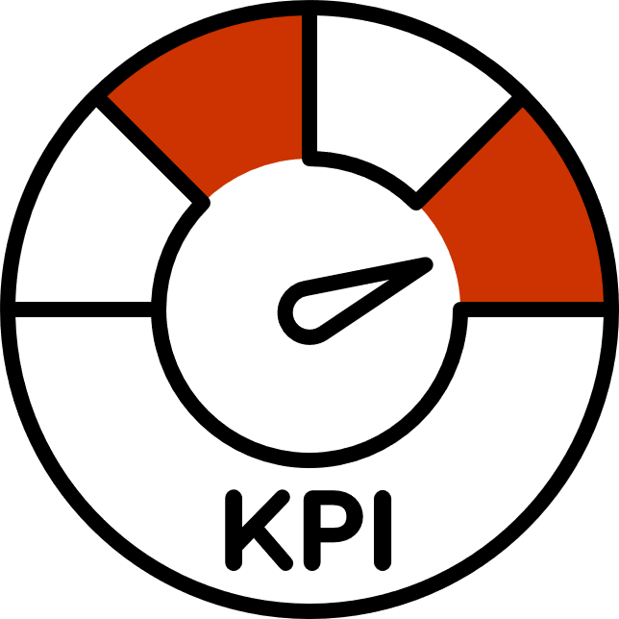

KEY PERFORMANCE INDICATORS
Digital KPIs
Engagement rate on Instagram and TikTok
Amount of UGC using official hashtags
Website/App traffic to community and event sections
Conversion from social content to product pages
Community KPIs
Attendance at teen-focused events
Growth of the teen ambassador network
Repeat purchase rate for the teen segment
Loyalty program sign-ups (ages 18–45)
Sentiment analysis (brand perception among teens)
Influencer KPIs
Engagement and sales impact of teen ambassadors
Code-based sales tracking
Event turnout driven by influencers
“These KPIs collectively measure community growth, brand engagement, and long-term loyalty within the segmentation.”

Slide 20


RECOMMENDATIONS
1. “Lulu Fit EU” Digital Community with a friendly fitness hub hosting Weekly challenges Leaderboards Free online classes Creator-led workouts | 2. TikTok-First Marketing Weekly creator series European teen fitness ambassadors Viral hashtag challenges (#LuluFitEU)
3. Gamified App Experience Streaks Badges Team competitions | 4. Pop-Up Fitness Labs Across Europe School/college partnerships Teen gym events Free fitness “Try Days”
CONCLUSION
Lululemon’s entry into the German and broader European market presents a major growth opportunity driven by rising demand for fitness, wellbeing, sustainability, and premium athleisure.
Strategic analysis using SWOT and STP shows strong brand equity and innovation potential, but highlights the need for cultural adaptation and regulatory alignment in Europe.
A localized, data-driven digital strategy—powered by influencer partnerships, sustainability-focused messaging, and seamless omnichannel engagement—can significantly strengthen Lululemon’s market presence.
With a focus on compliance, inclusivity, and community-building initiatives, Lululemon is well positioned to achieve sustained growth, competitive advantage, and long-term loyalty across Germany and Europe.

Slide 21
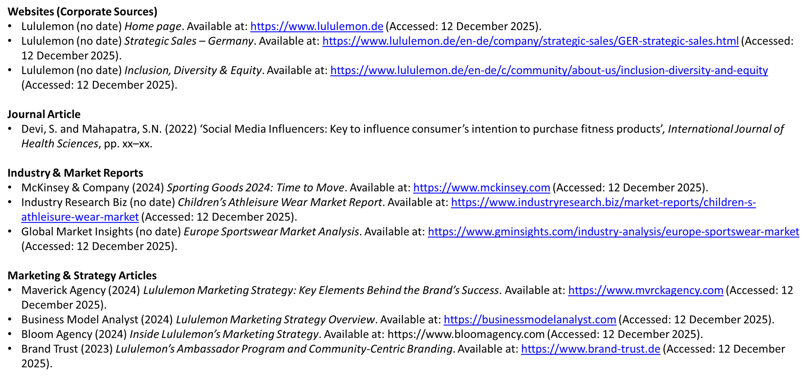
REFERENCES

Slide 22
Thank You.
www.lululemon.de/en-de/home

